Slide 1
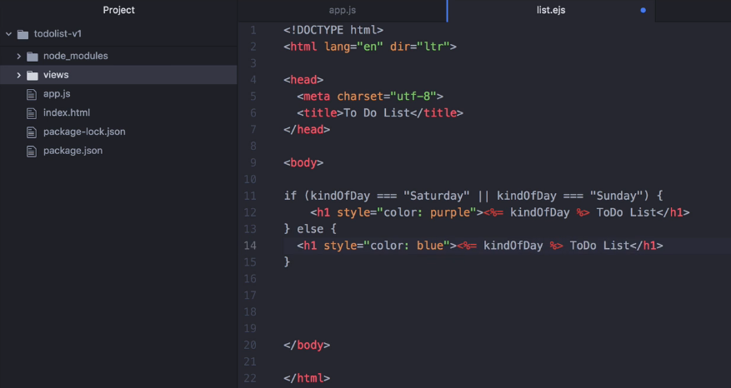
Passing Data from web page to server

Slide 2
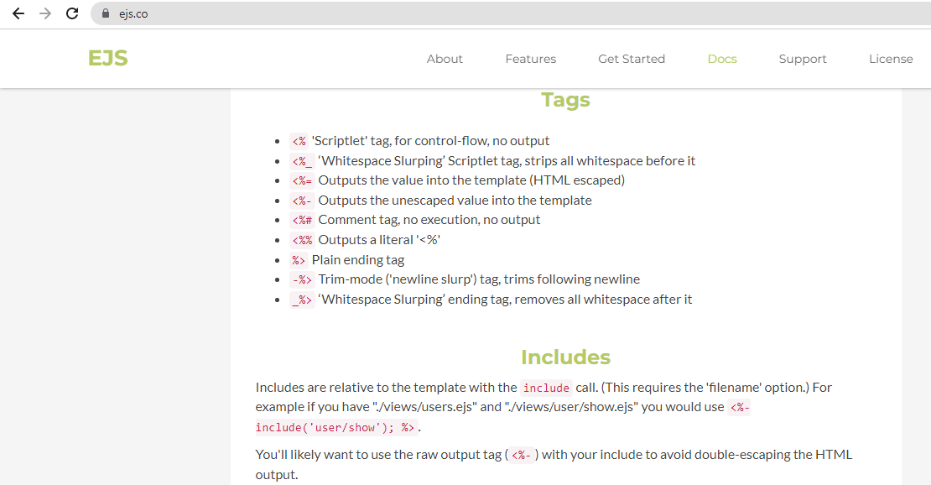

Slide 3
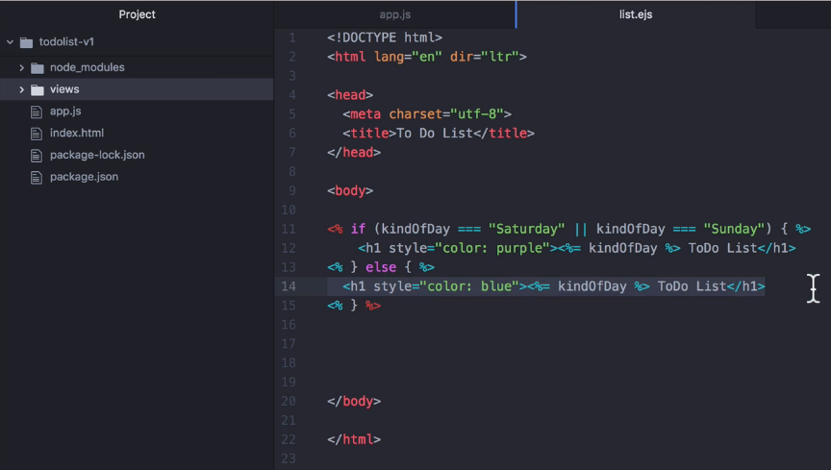
Adding Scriptlet tag at ejs file

Slide 4
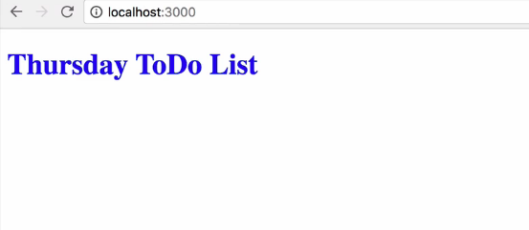

Slide 5
Passing Data from web page
to server

Slide 6
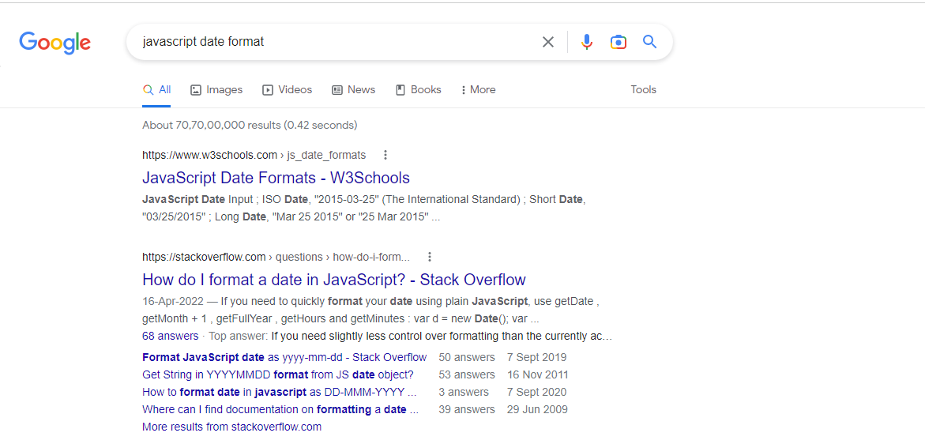
Search

Slide 7
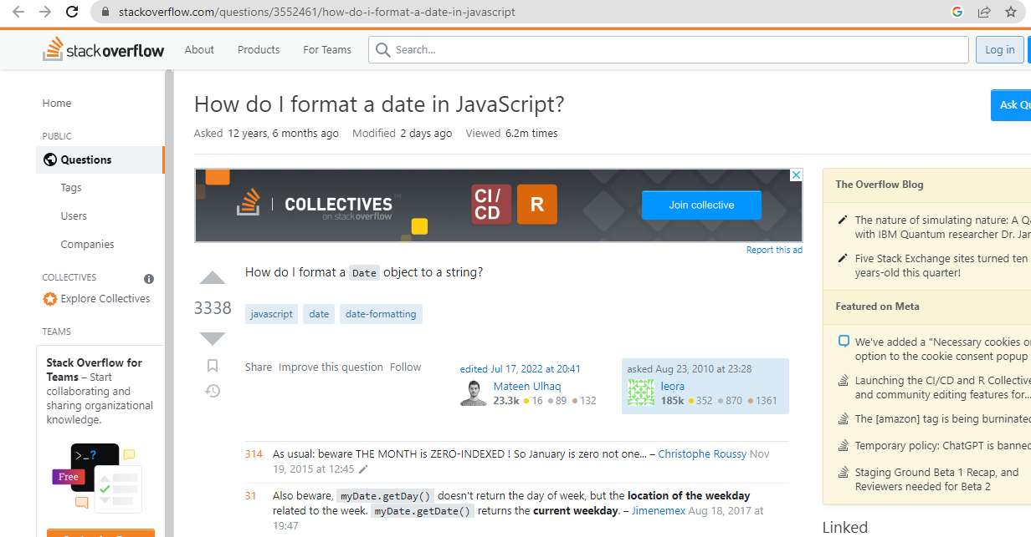

Slide 8
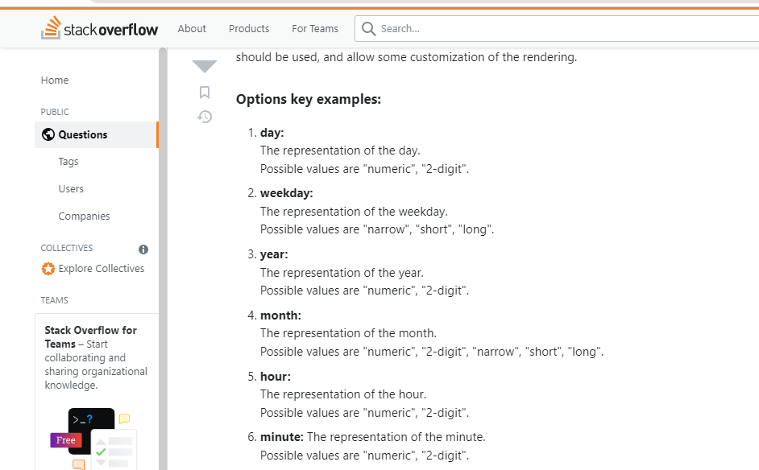

Slide 9
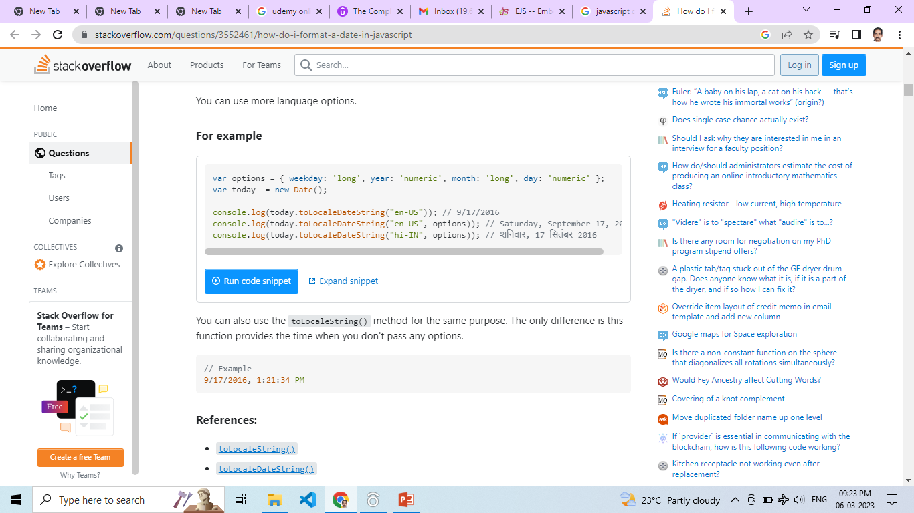

Slide 10
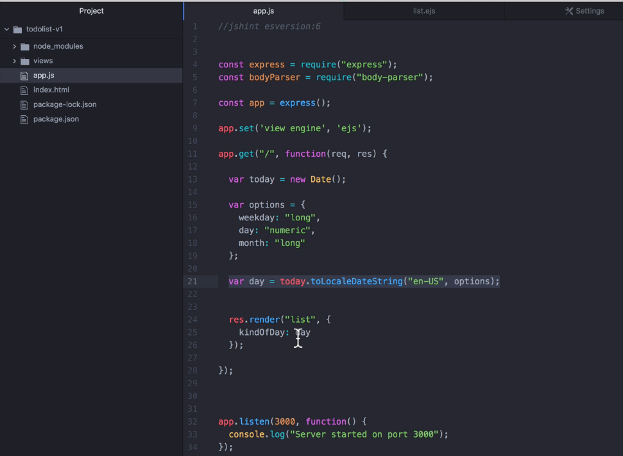

Slide 11
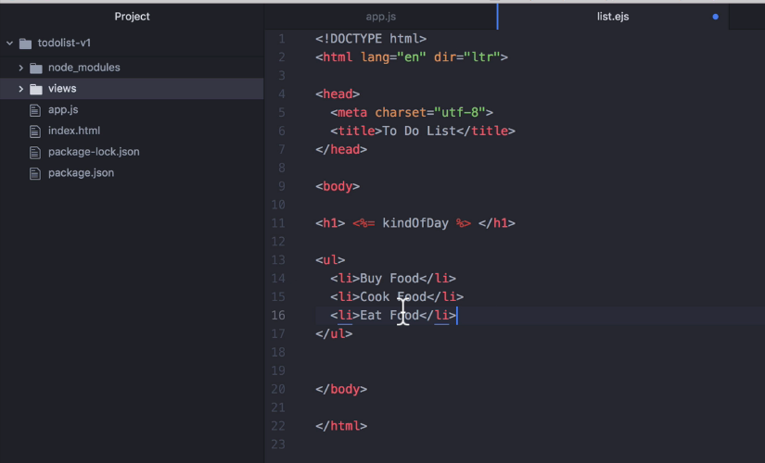

Slide 12
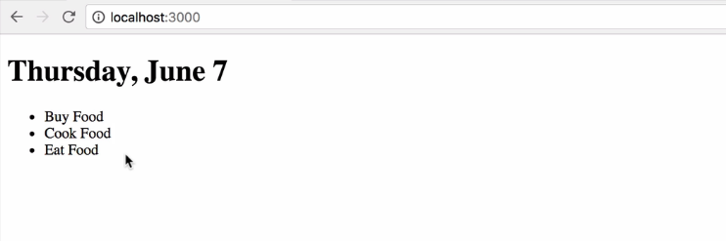

Slide 13
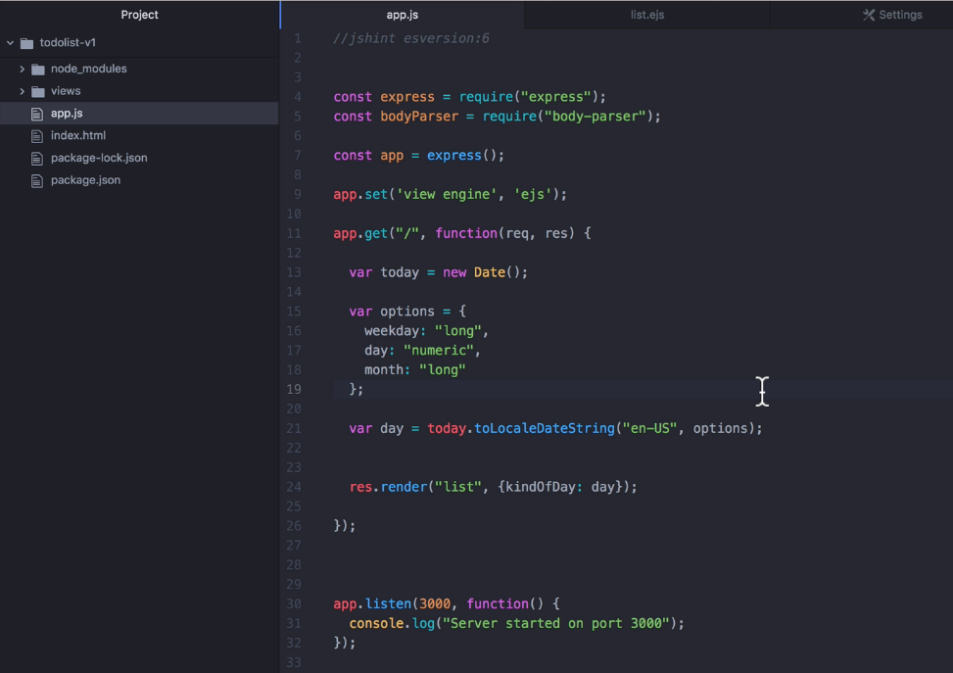

Slide 14
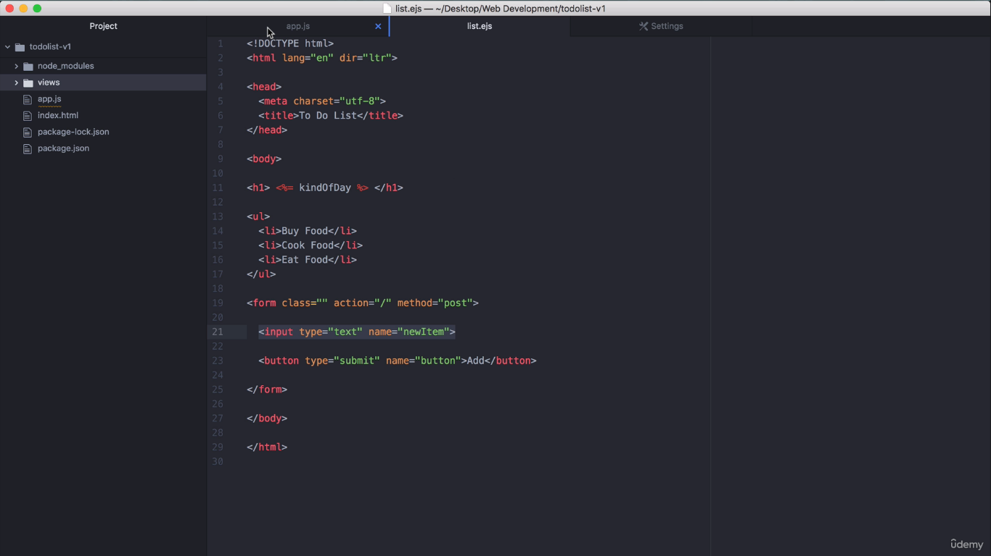

Slide 15
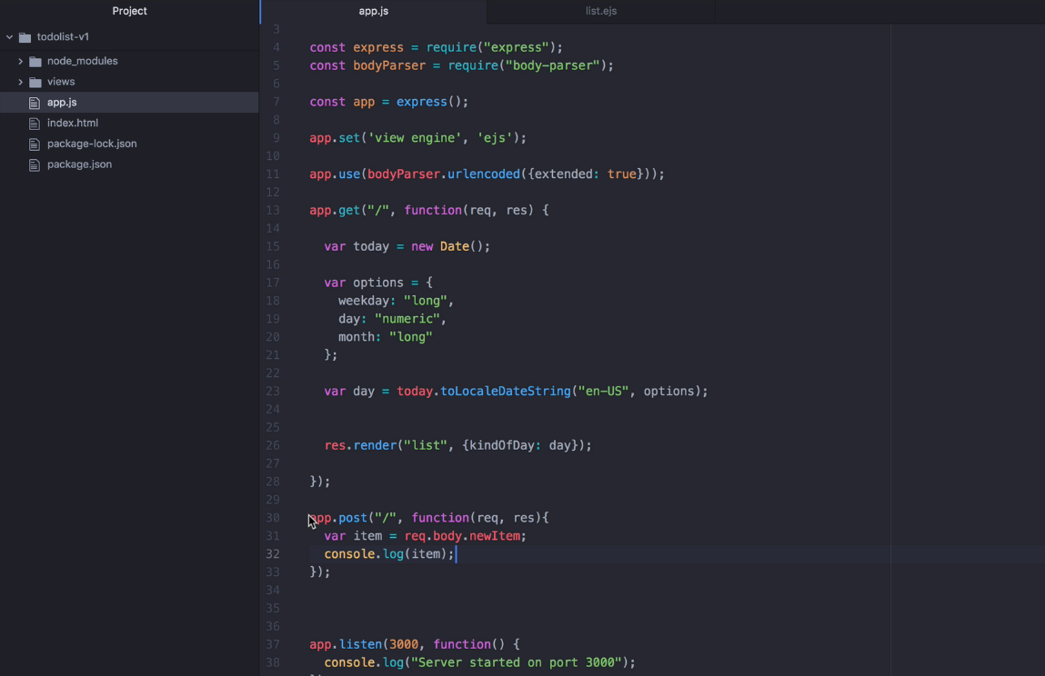

Slide 16
Run previous slide content, verify the output
at console.log.

Slide 17
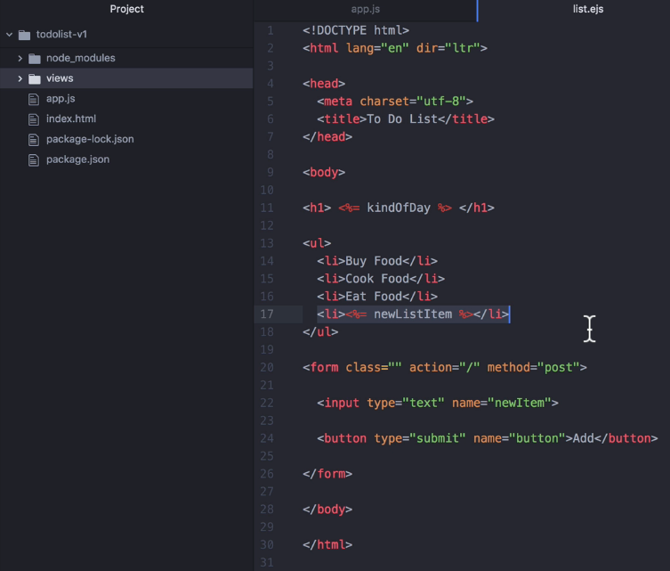
Adding new <li> in
list.ejs file

Slide 18
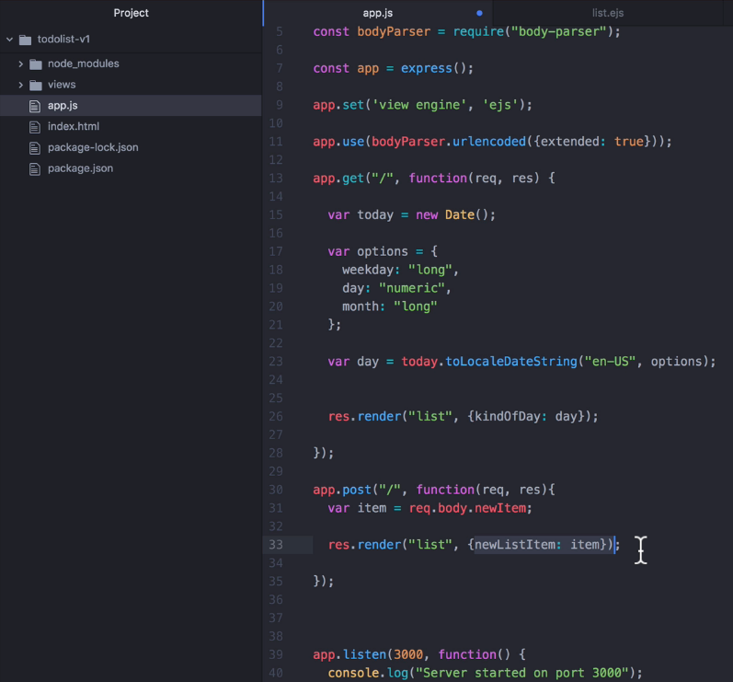
Adding newListItem in
app.js file

Slide 19
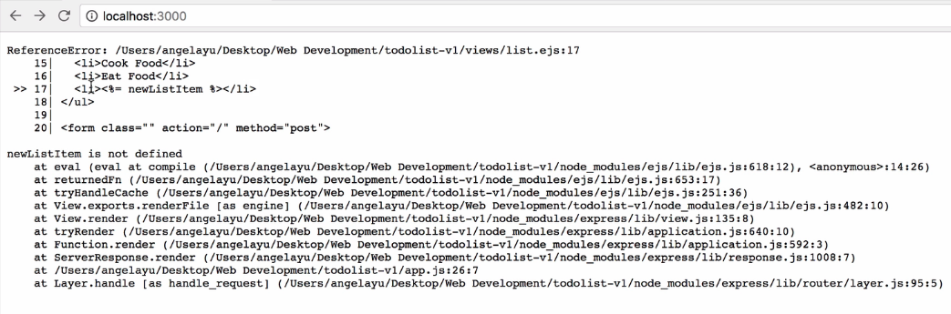
If you run previous slide code, then We may get reference error.

Slide 20
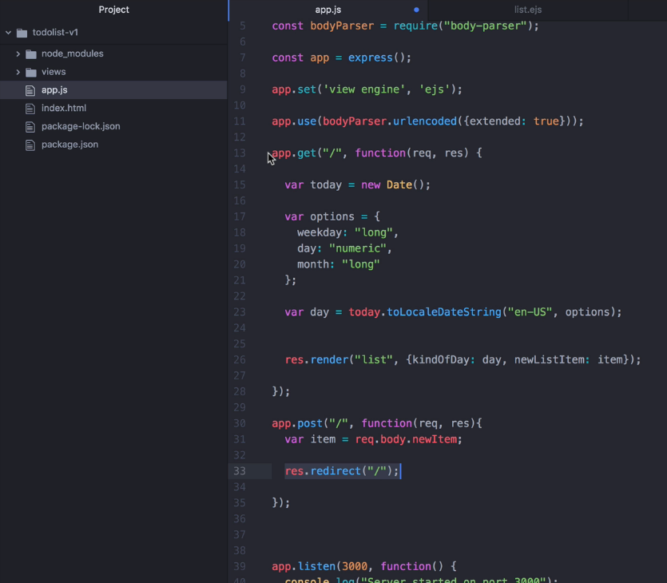
Using res.redirect in
app.js file

Slide 21
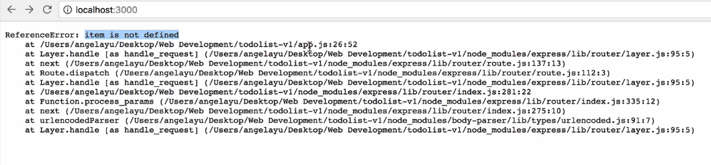
If you run previous slide code, then We may get reference error once again.

Slide 22
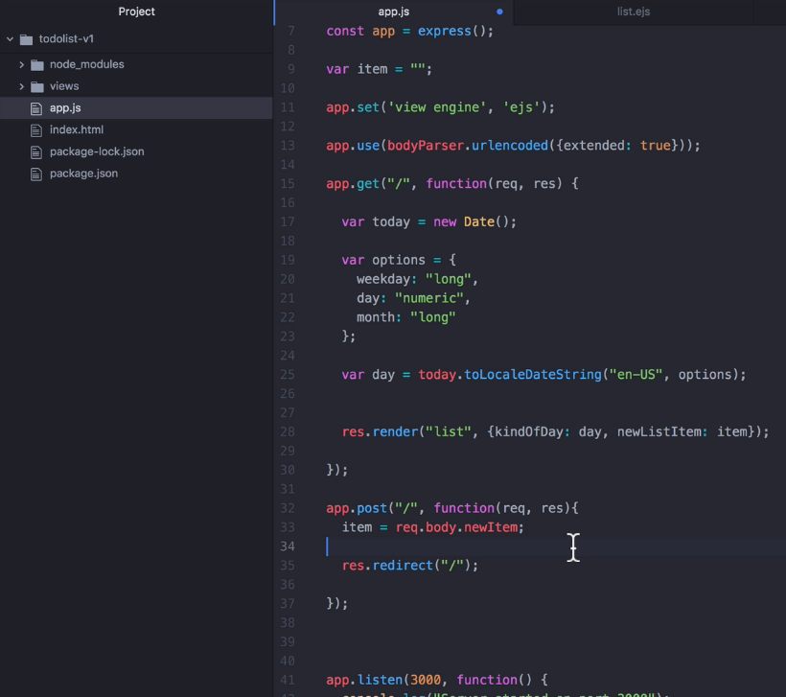
Declaring item variable
Globally in
app.js file

Slide 23
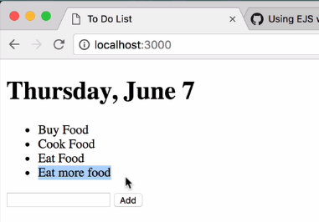
When we add new item in the list, the new item will replace
existing item in the list

Slide 24
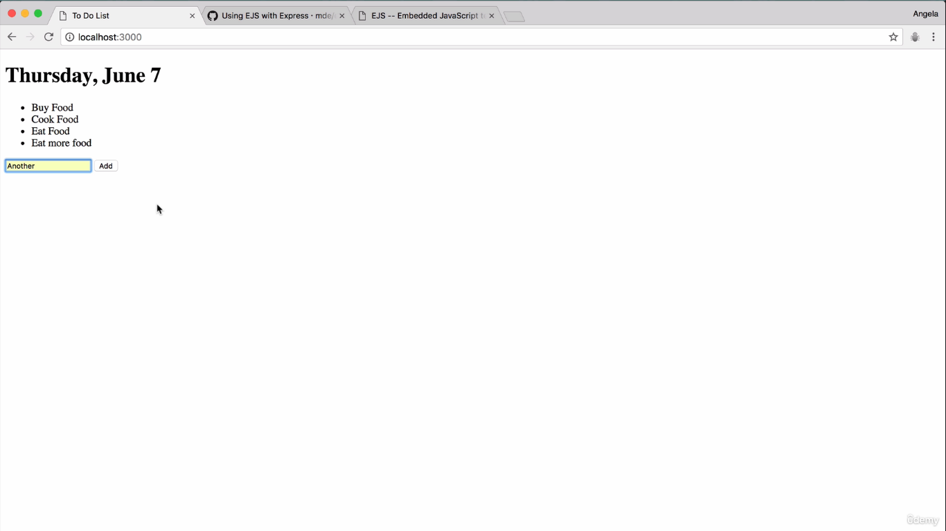
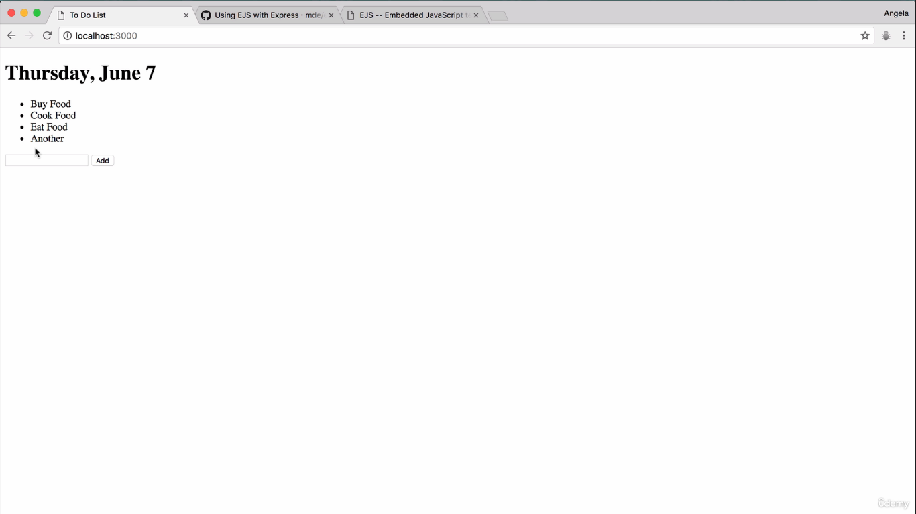

Slide 25
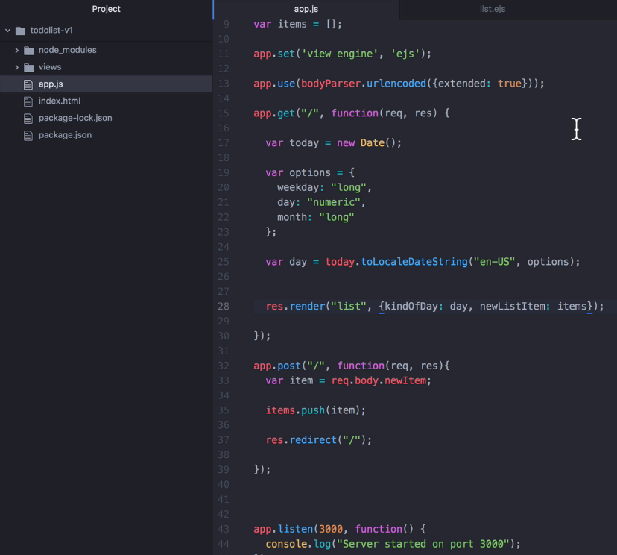
Declaring items variable
as Array Globally in
app.js file

Slide 26
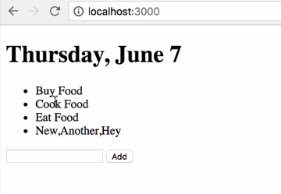
Again if we add new item
It is storing in array with comma

Slide 27
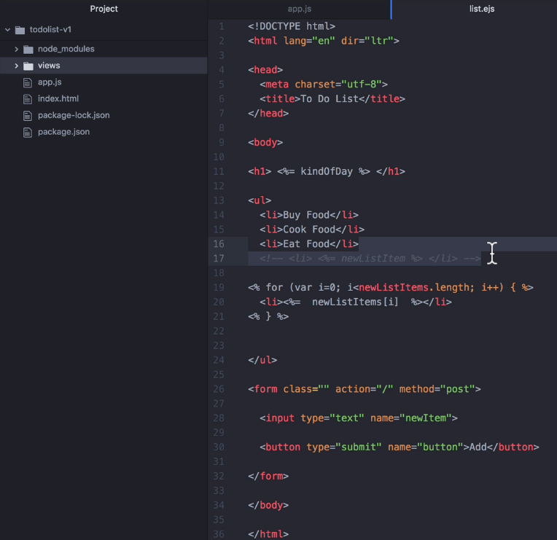
Use for loop to
Iterate array of elements and render one item for each time.

Slide 28
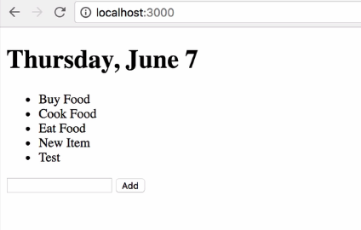

Slide 29
To simplify a task we can add list item
in array (inside app.js),
and remove from html file.

Slide 30
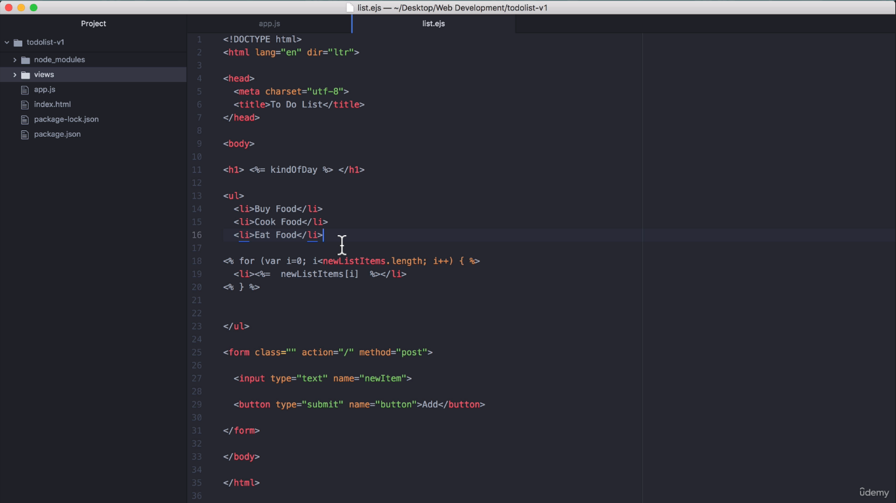
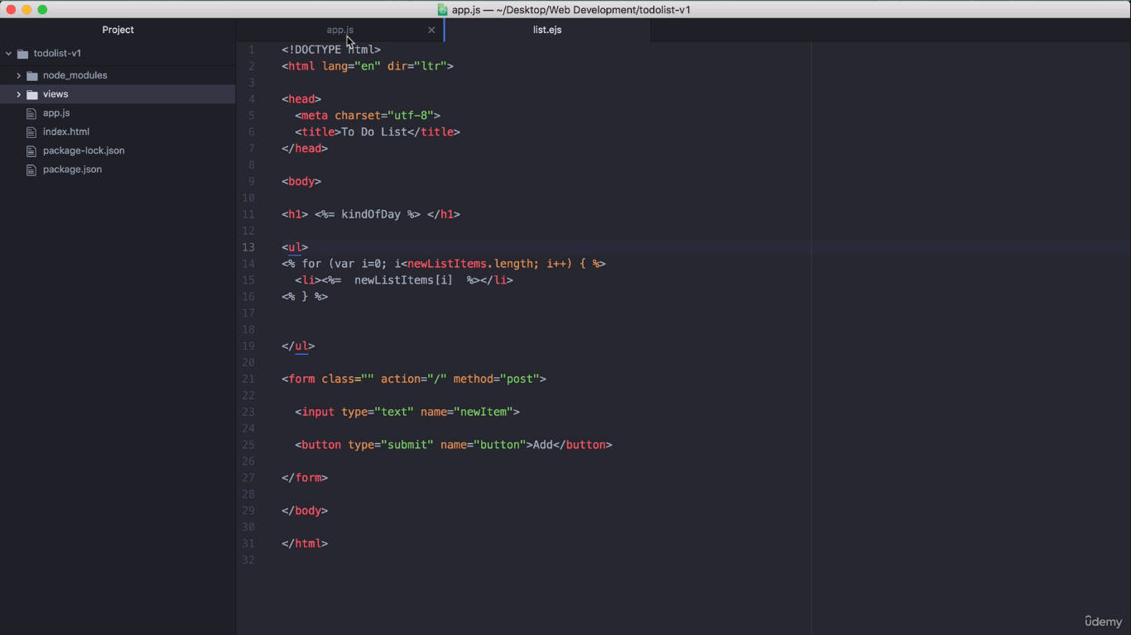

Slide 31
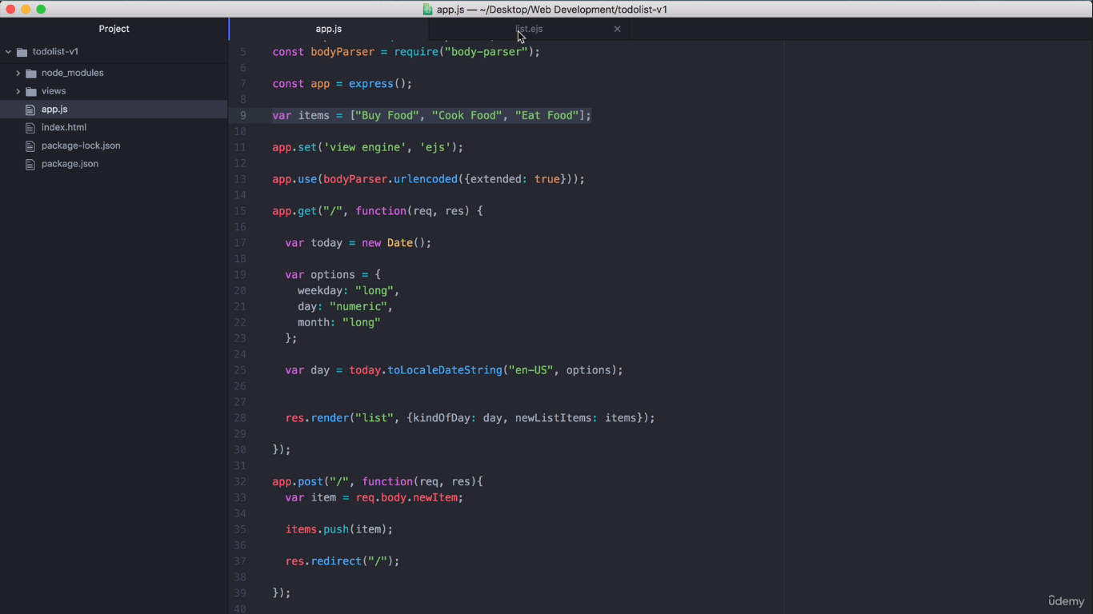
Adding default values in array

Slide 32


